Slide 1
IOT Based Garage Door Opener
Presented By : Manpreet Kaur c0757604
(Group 4)

Slide 2
Content
Overview : Hardware Testing and its importance
Arduino Board
IR Sensor
20*4 LCD Display
GSM Module
Buzzer
DC Motor
L298N motor driver

Slide 3
Hardware Testing and its importance
Testing is the practice of making objective judgments regarding the extent to which the system (device) meets, exceeds or fails to meet stated objective.
Testing is about verifying that what was specified is what was delivered: it verifies that the product (system) meets the functional, performance, design, and implementation requirements identified in the procurement specifications.
Test (Formal) - Formal testing is the verification that a specification requirement has been met by measuring, recording, or evaluating data obtained during controlled exercises under all appropriate conditions using real and/or simulated stimulus.
Hardware Testing plays an important in overall success of the Capstone project.

Slide 4
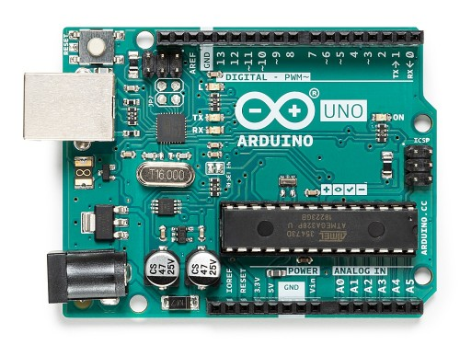
Arduino Uno Board
Arduino Uno is a microcontroller board based on the ATmega328P. It has 14 digital input/output pins (of which 6 can be used as PWM Outputs), 6 analog inputs, a 16MHZ quartz crystal , a USB connection, a power jack, an ICSP header and a reset button. It contains everything needed to support the microcontroller; simply connect it to a a computer with a USB cable power it with a AC-to DC adapter or battery to get started.
.
.

Slide 5
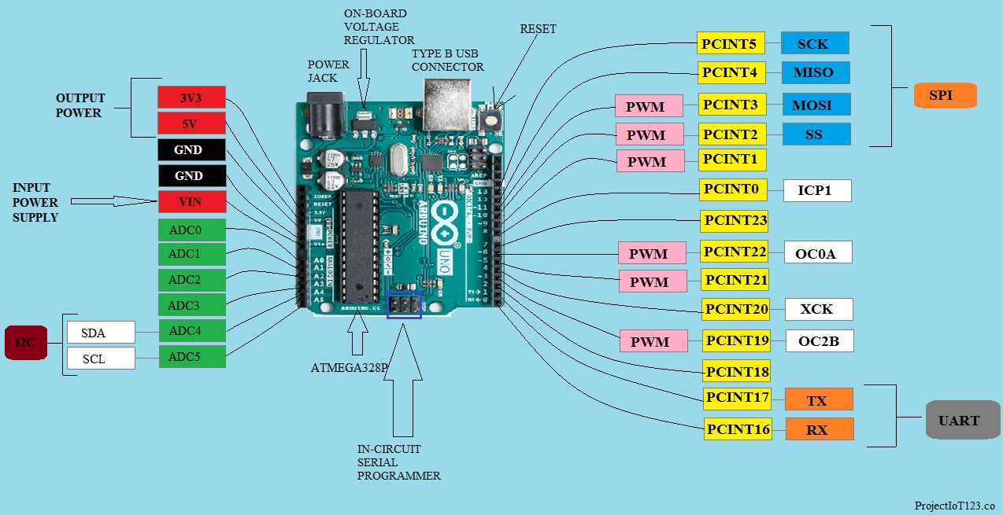
Pin Diagram of Arduino

Slide 6
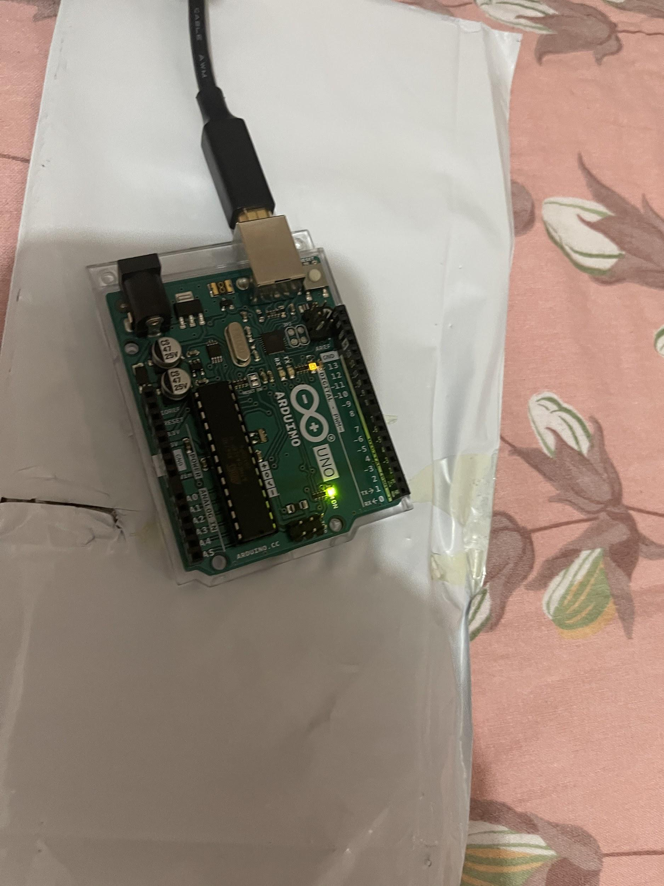
Testing of Arduino
Arduino was plugged into the laptop via Arduino usb cable. It started Booting.
Testing of Arduino board was conducted checking its connection on Arduino Ide and uploading different programs for other devices. It ran successfully.

Slide 7
IR Sensor
IR Sensors are Infrared sensors. It uses the Infrared light to detect if there is any obstacle in between the area. It has IR led which will reflect the light and the component next to IR led is a Photodiode which will receive reflected light if there is any obstacle present. The blue nob is the Potentiometer on IR sensor , which can be adjusted to select the range. There are two small indicators on the sensor ; one indicates the sensor is on and the other one will light up when the receiver photodiode will receive light from the obstacle.The IR sensor gives digital output only in the form of 0 and 1.

Slide 8
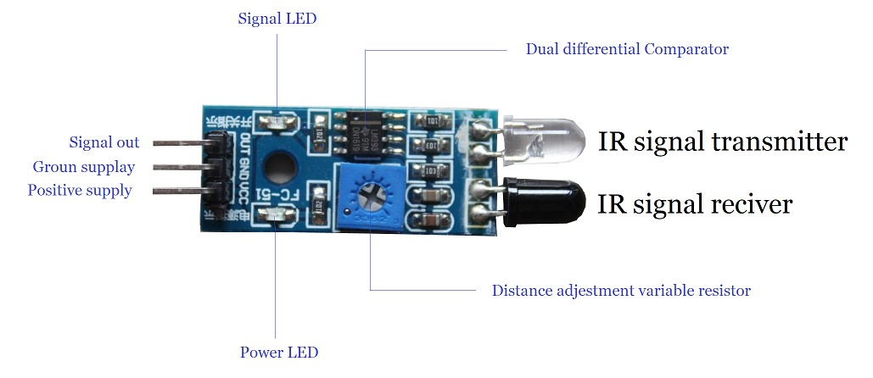
Pin Diagram of IR Sensor

Slide 9
Connections of IR Sensor with Arduino for testing
IR sensor Arduino
Ground Ground
VCC 5V
Output Pin Digital Output Pin 2

Slide 10
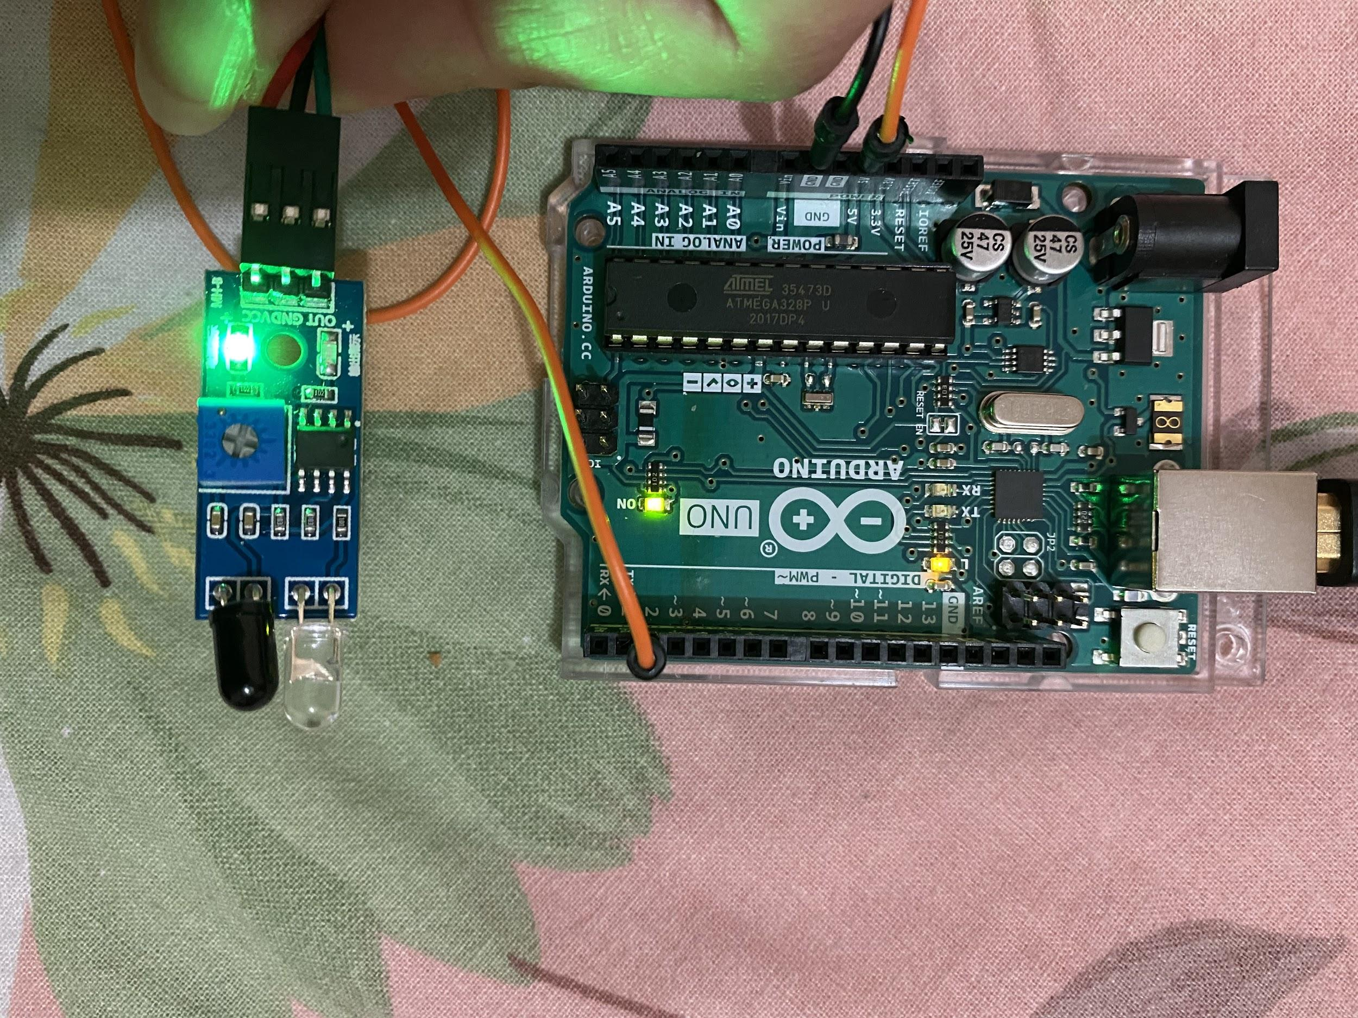
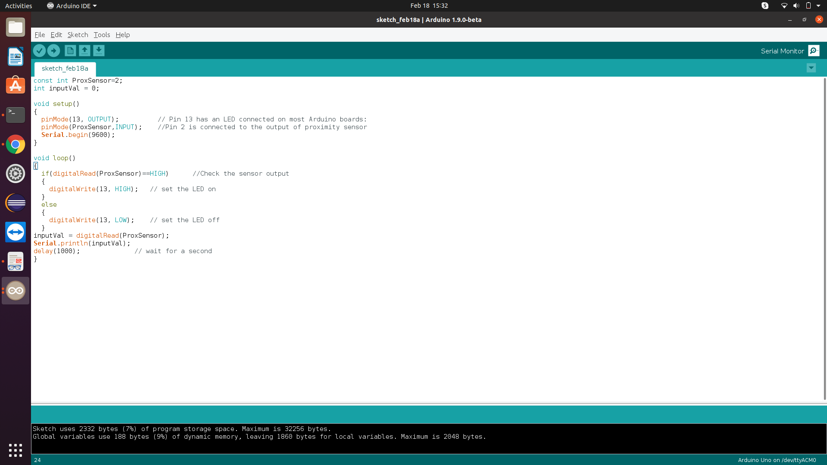
Testing of IR Sensor by powering it up
.
.
Signal for power on

Slide 11
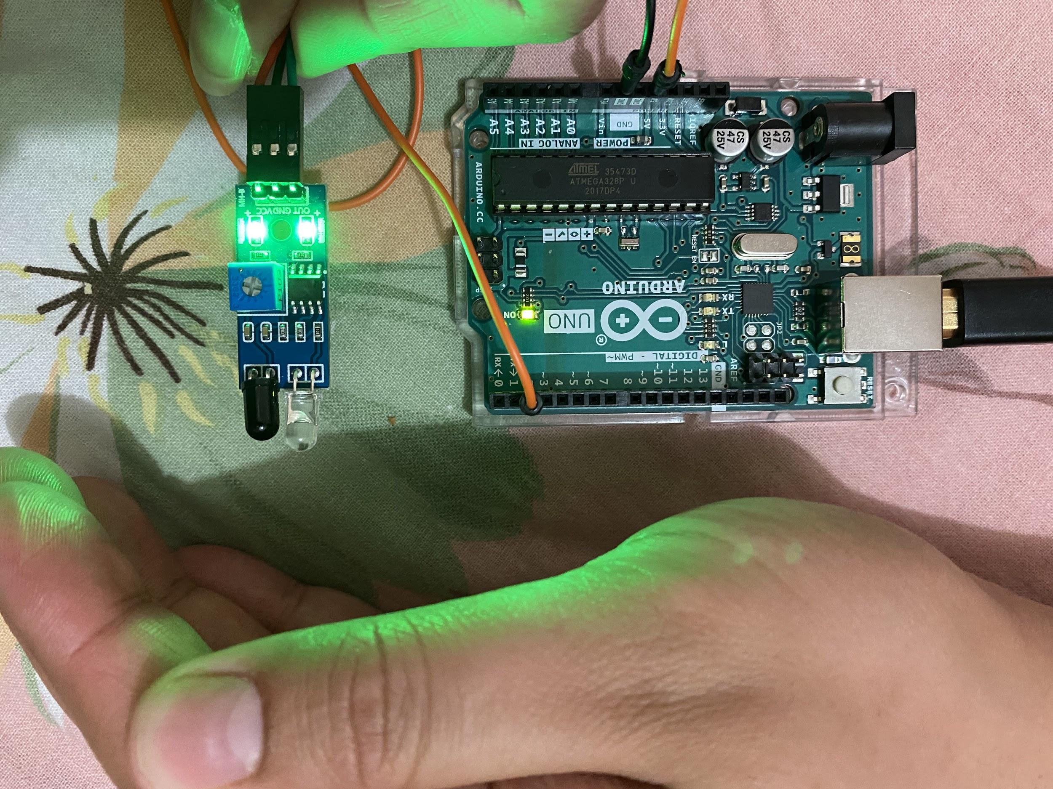
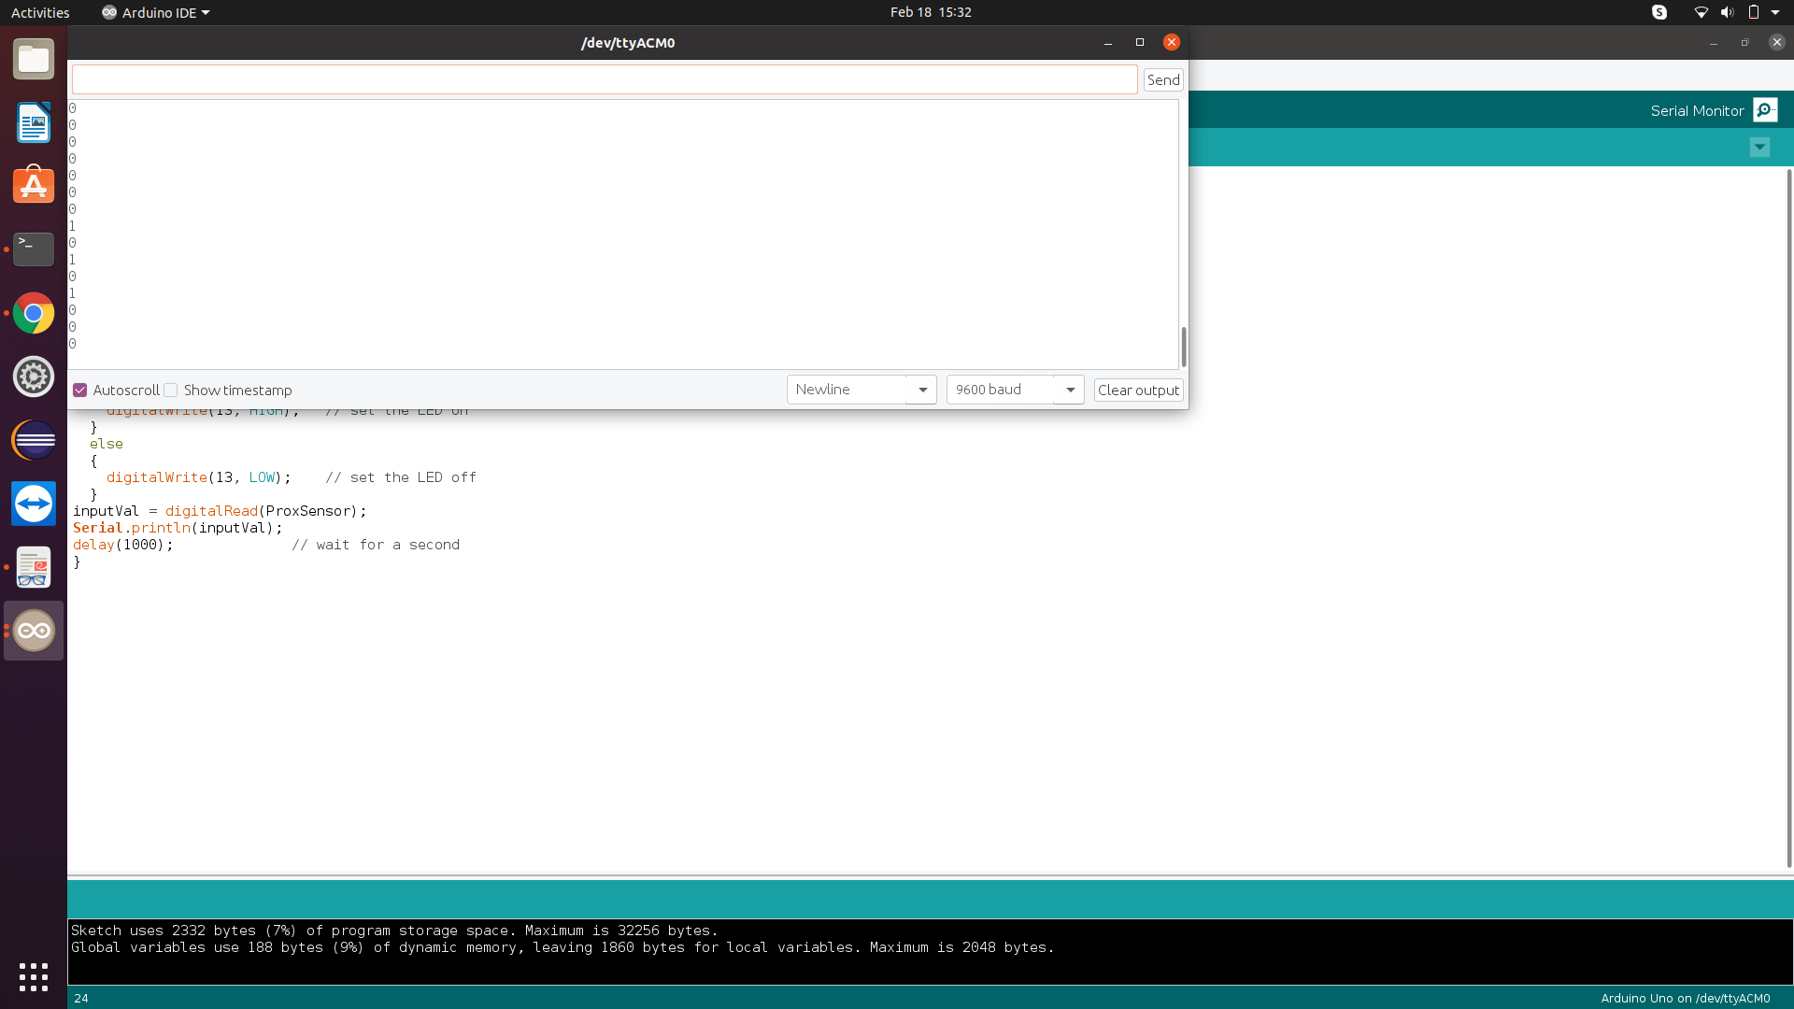
Testing an obstacle detection with IR Sensor
.
Led glow up in presence of obstcale
.

Slide 12
LCD Display
In our Capstone project we are using LCD to display messages for user. We are using 20*4 LCD display. It is very important to test display before we implement it in our final project. For this we checked the clear visual of characters displayed on the screen. We checked special characters on the display as well. Interfacing of Arduino with LCD was done to conduct the testing.

Slide 13
Connections of LCD Display with Arduino for testing
LCD Display Arduino
Ground Ground
VCC 5V
SDA A4
SCL A5

Slide 14
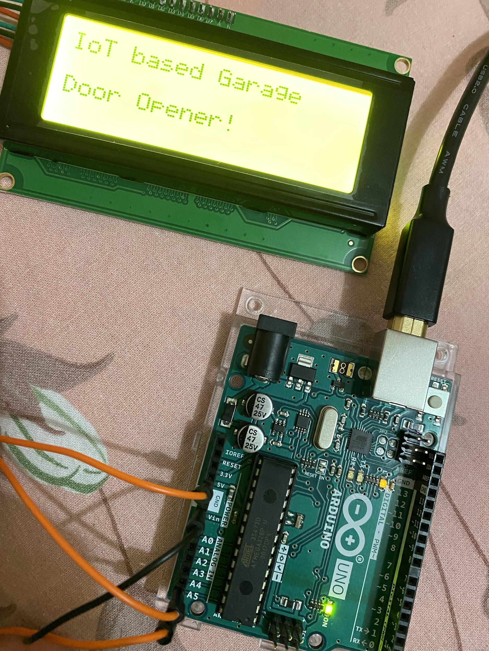
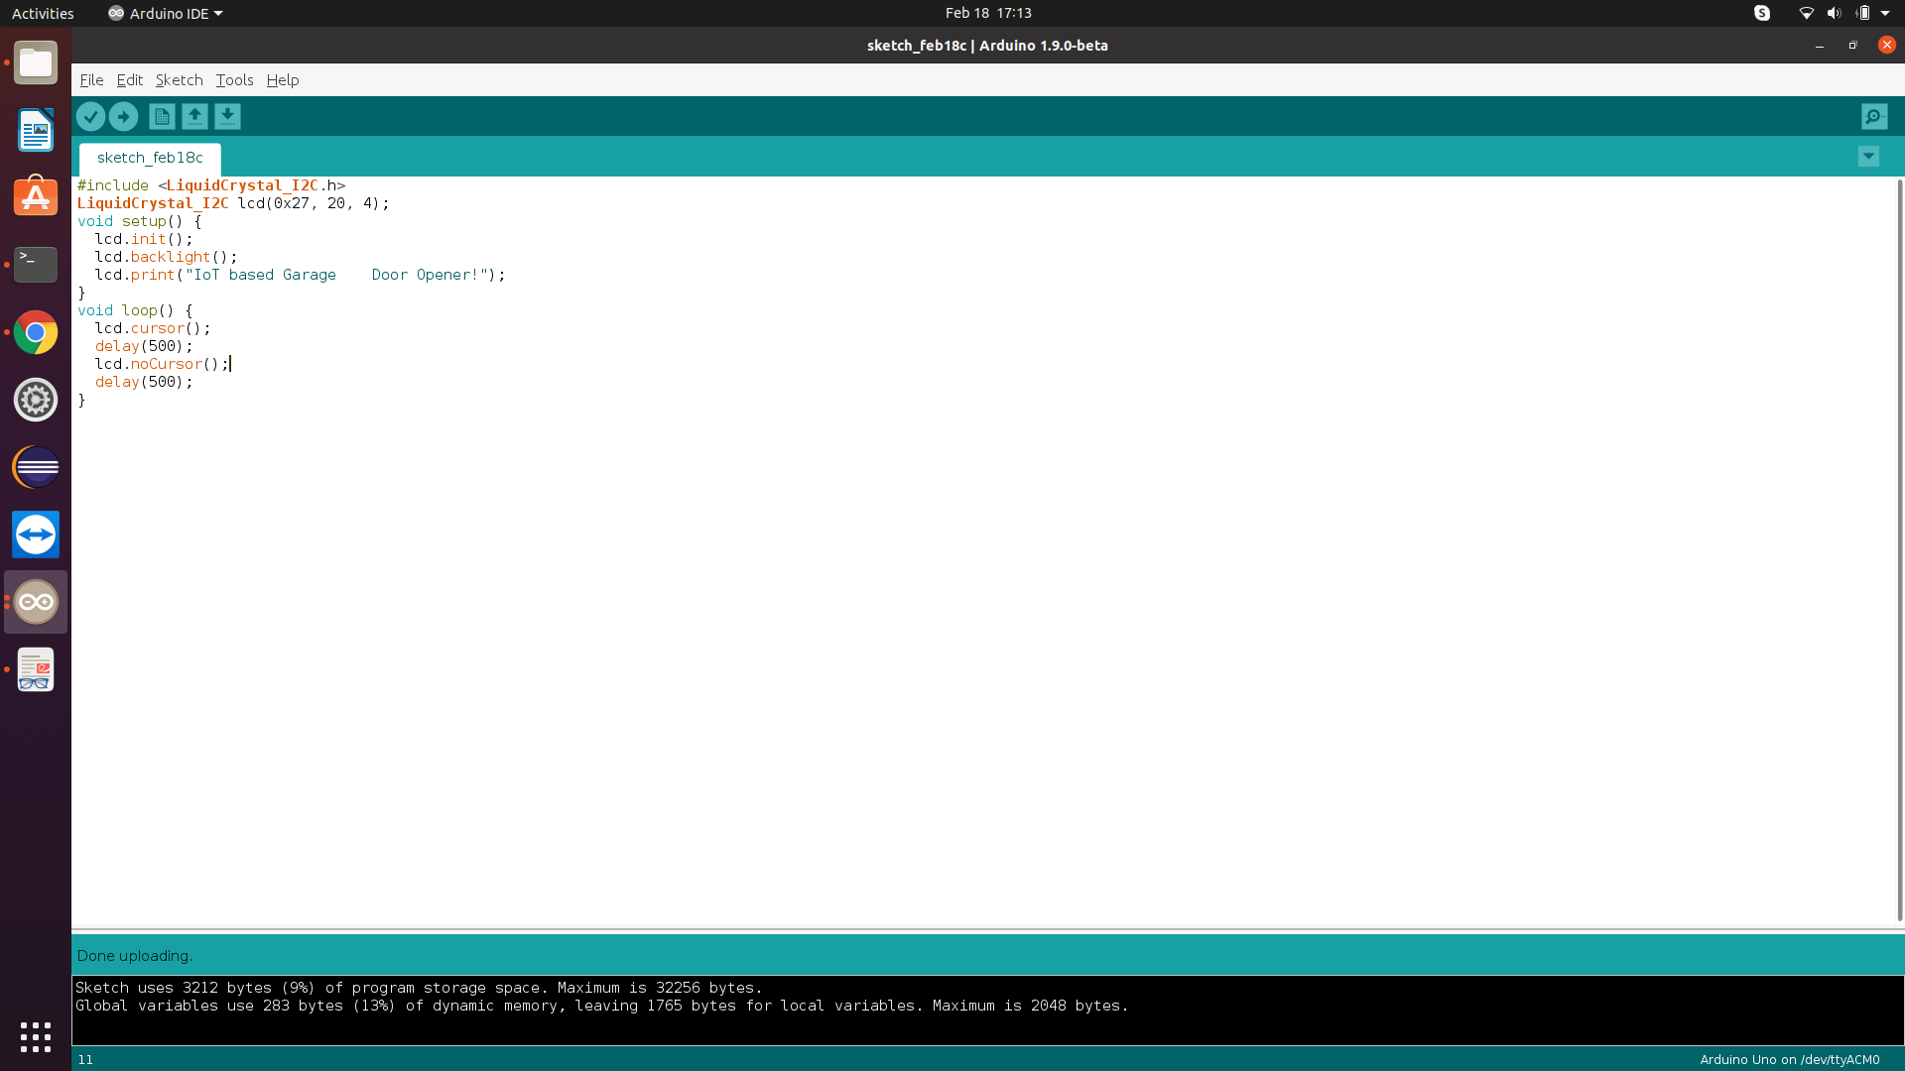
Testing of LCD Display with Arduino
.
.

Slide 15
Buzzer
Buzzer ia a device which will produce signalling noise to alert user whenever the door remains open for long time. Also, whenever there is an obstacle in between the door while closing. We are using CLT1036 buzzer which requires 4-8 v DC supply to operate. We connected our buzzer directly to Arduino and tested its performance.

Slide 16
Connections of Buzzer with Arduino for testing
Buzzer Arduino
Ground Ground
VCC Pin 11

Slide 17
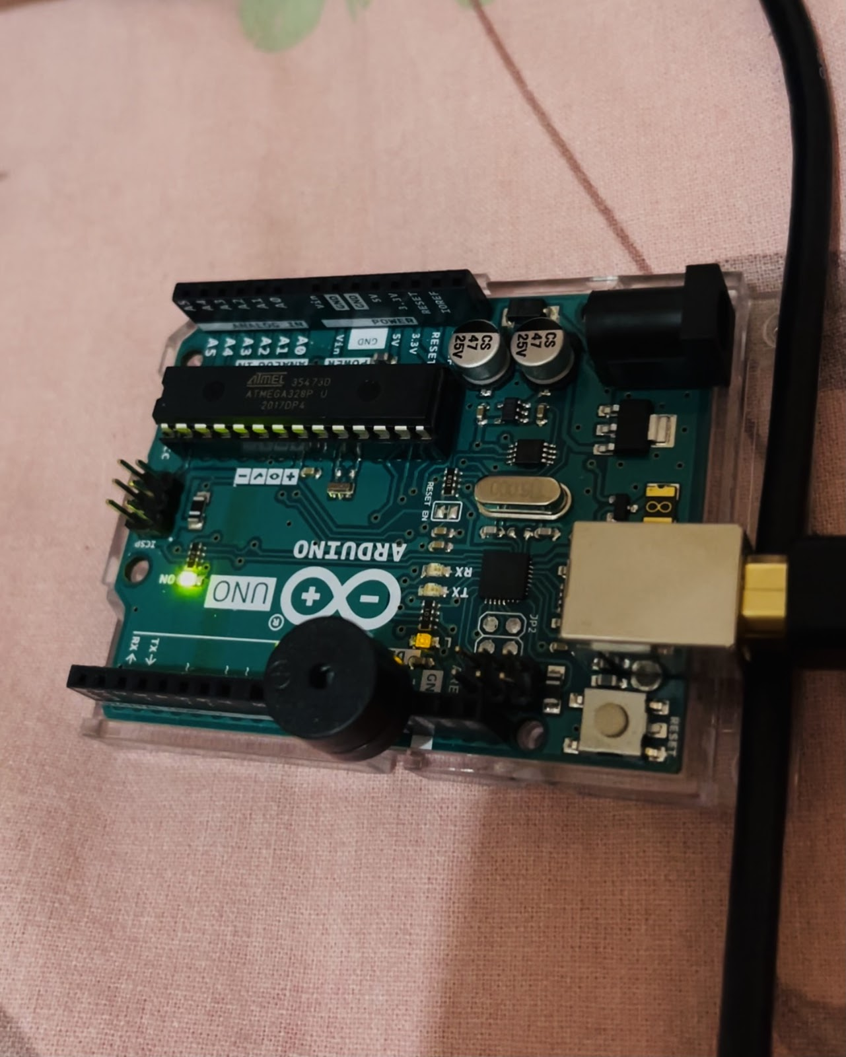
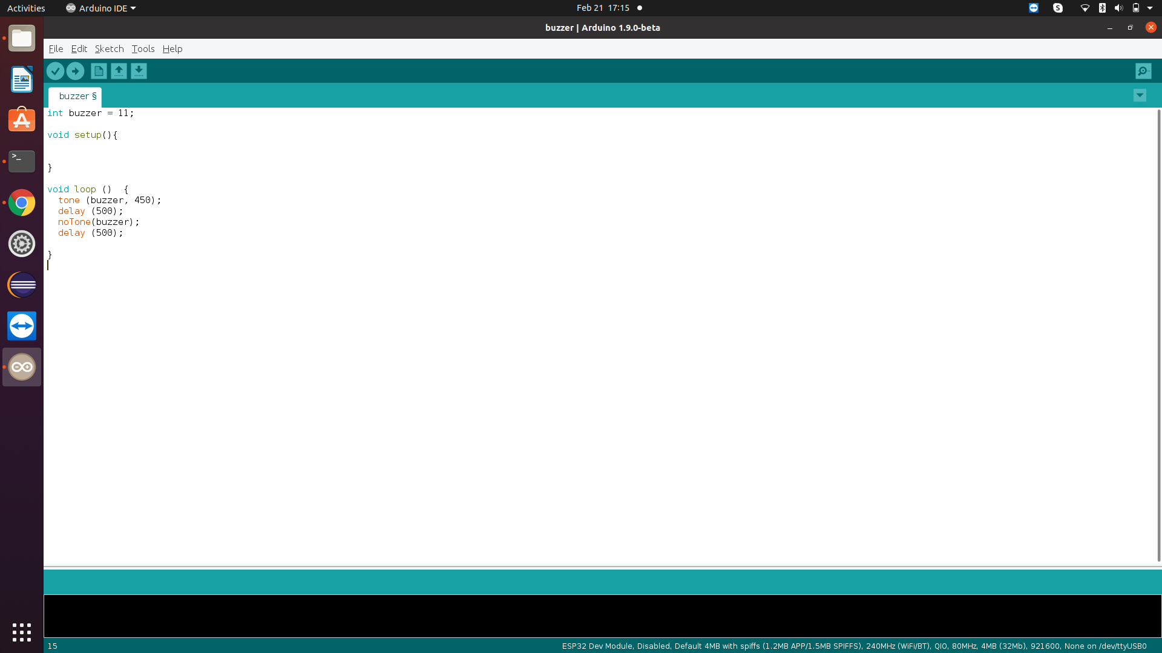



Slide 18
L298N Motor Driver and DC motor
The L298N is a dual H- Bridge motor driver which allows speed and direction control of two dc motors at the same time. The module can drive the DC motor that have voltages between 5 and 35V, with a peak current up to 2A. In our project we will use only one port for Dc motor.
DC motor is rotary mechanism that will convert the direct current to a mechanical movement, in our case it will open and close the garage door.

Slide 19
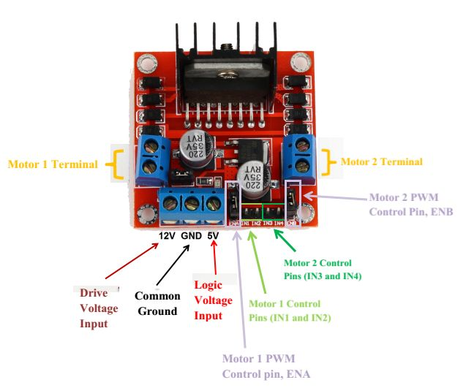
Pin Diagram of L298N

Slide 20
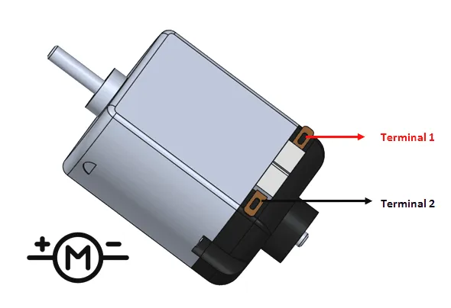
Pin Diagram of Dc Motor

Slide 21
Connections of L298N and DC motor with Arduino for testing
L298N Arduino
Ground Ground
VCC 5V
Input V Battery 12V
DC Motor L298N
Terminal 1 Out 1
Terminal 2 Out 2

Slide 22
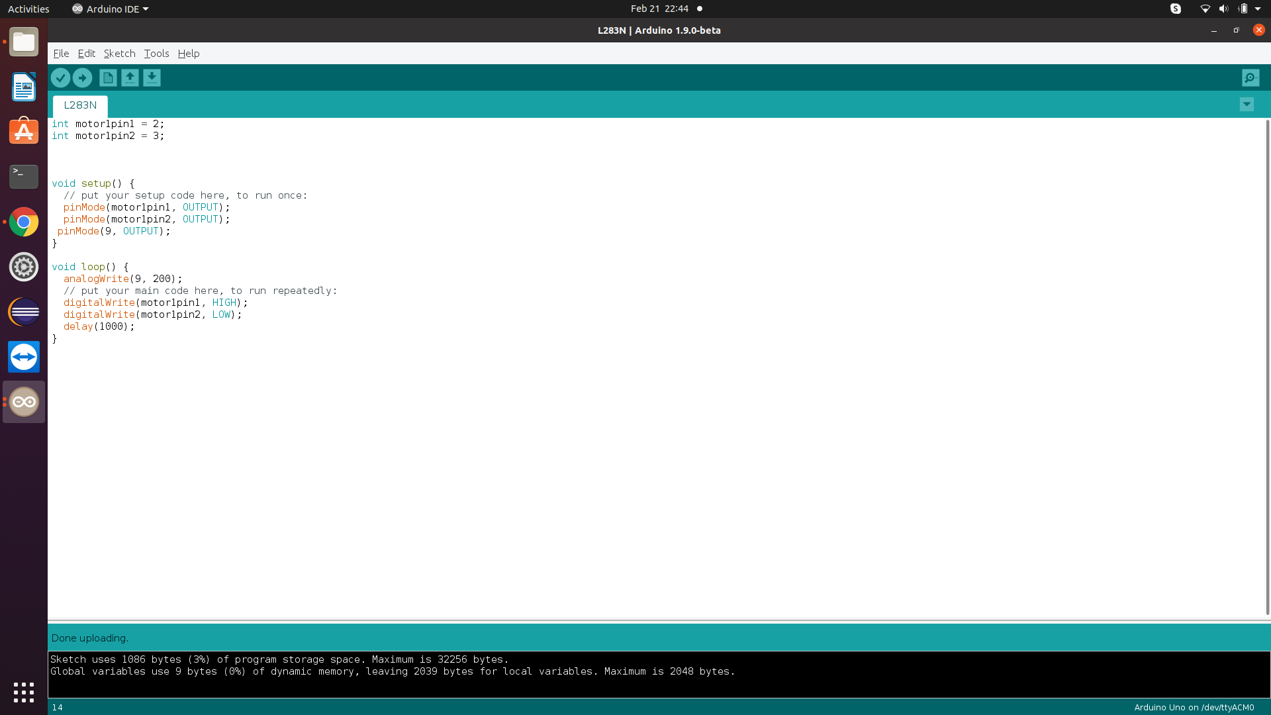

Slide 23
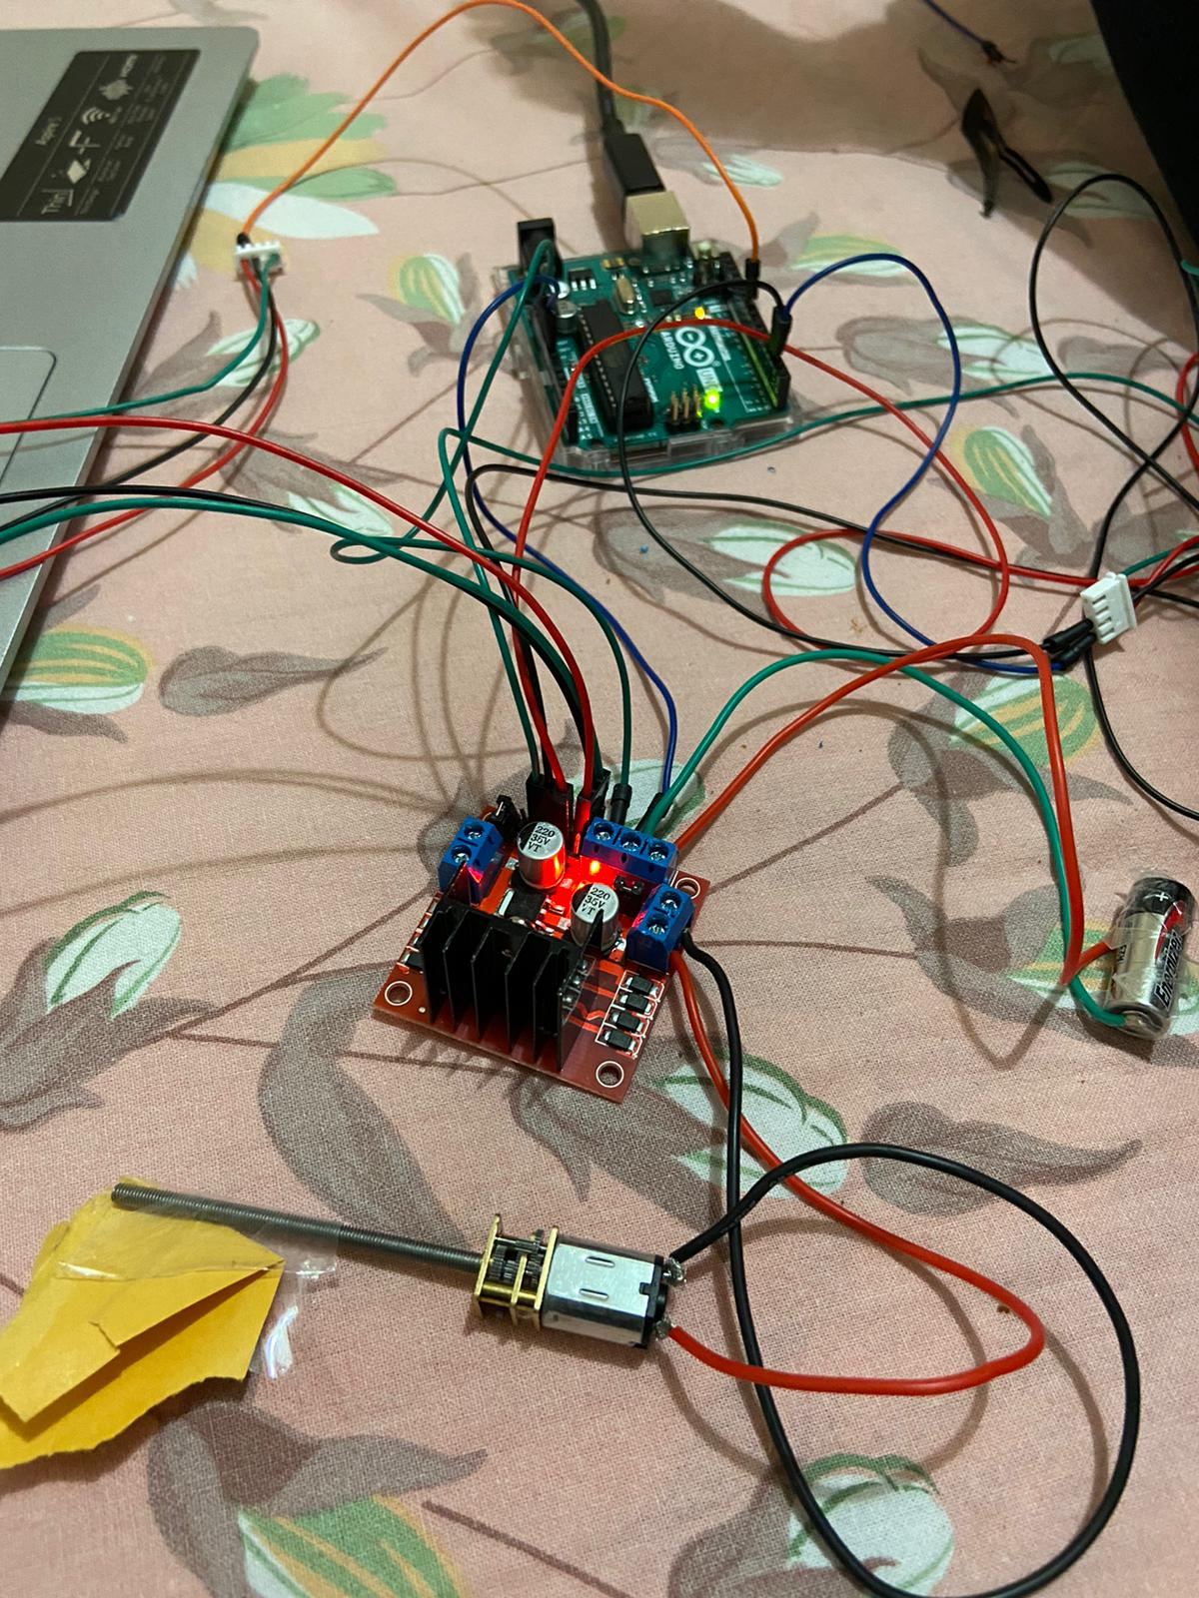

Slide 24
GSM Module SIM800L
GSM module is used to send SMS to user in particular situations. It will be interfaced with Arduino Uno. The testing was done via connecting GSM Module to Arduino Uno

Slide 25
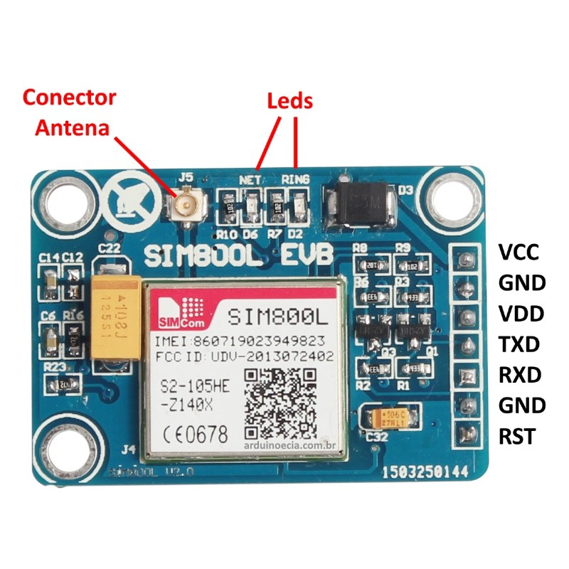
Pin Diagram of GSM Module

Slide 26
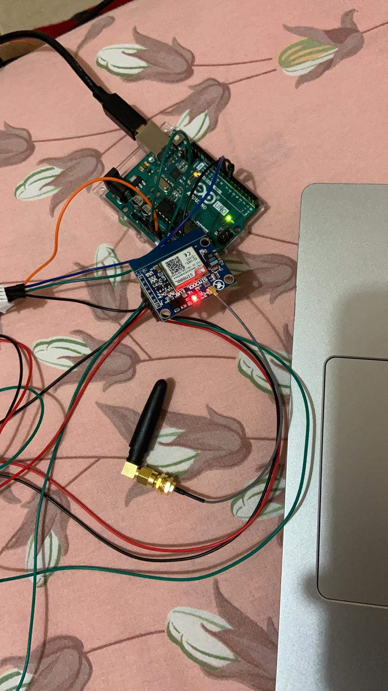
Testing of GSM module with Arduino

Slide 27
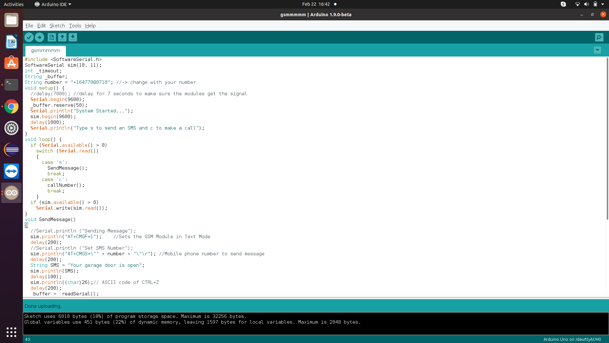

Slide 28
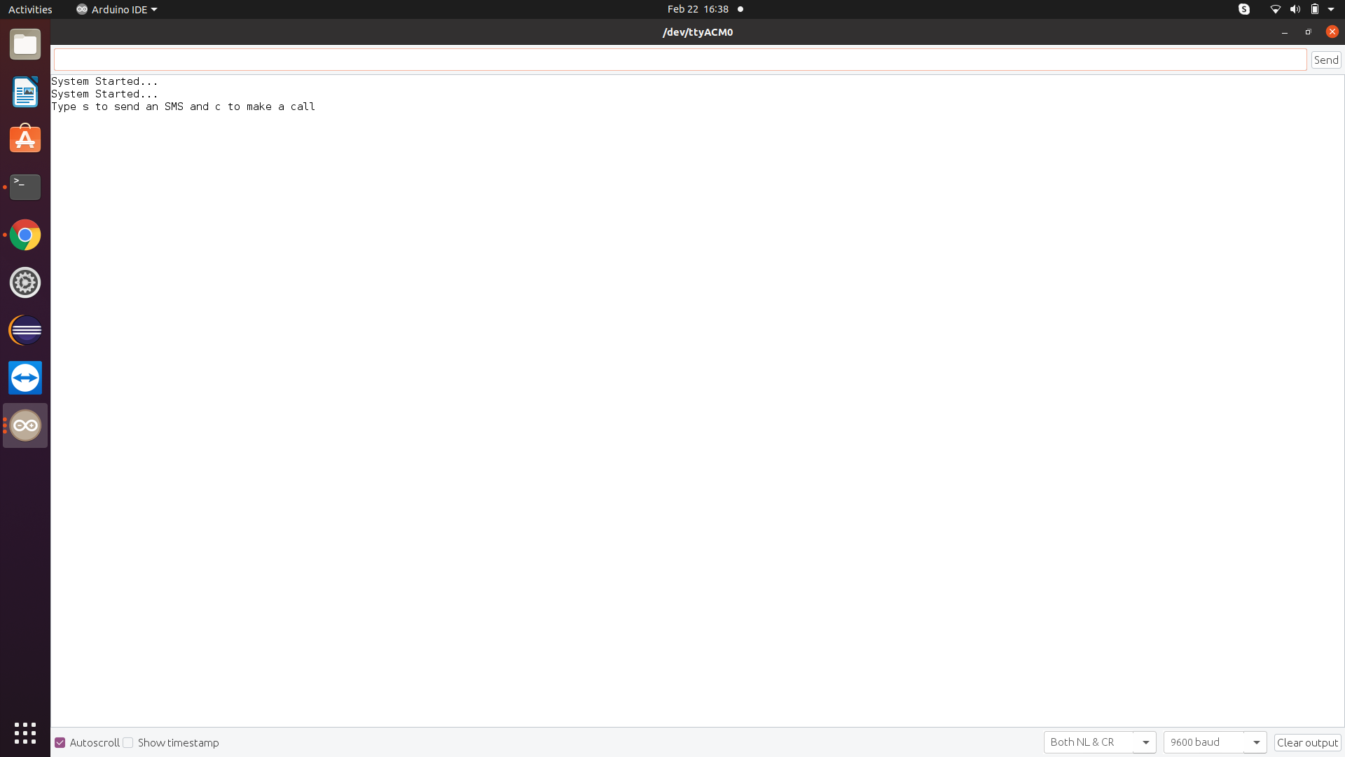

Slide 29
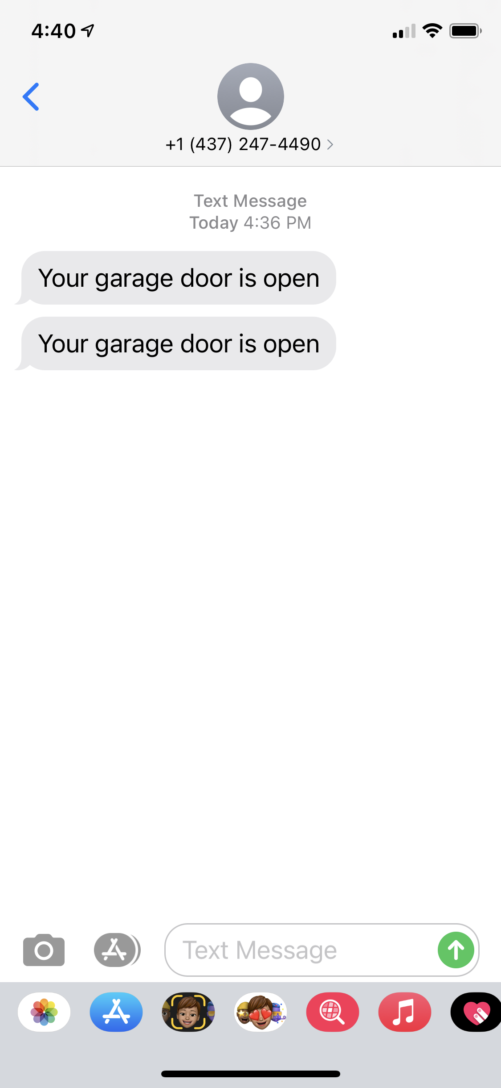

Slide 30
References
Arduino
Retrieved from, publiclab.com, October,2019, wmcarlf
URL: https://publiclab.org/notes/wmacfarl/10-22-2019/how-to-set-up-and-test-an-arduino
IR Sensor
Retrieved from, roboindia.com, 2021, tutorials digital analog IR pair Arduino
URL: https://roboindia.com/tutorials/digital-analog-ir-pair-arduino/
LCD Display
Retrieved from, makerguides.com, B.D. Bakker, May 2019
URL: https://www.makerguides.com/character-i2c-lcd-arduino-tutorial/
Buzzer
Retrieved from, projecthub, Suryateja, 2018
URL: https://create.arduino.cc/projecthub/SURYATEJA/use-a-buzzer-module-piezo-speaker-using-arduino-uno-89df45
L298N and DC Motor
Retrieved from, howtomechatronics.com, Dejan, August 2017
URL: https://howtomechatronics.com/tutorials/arduino/arduino-dc-motor-control-tutorial-l298n-pwm-h-bridge/
URL: https://create.arduino.cc/projecthub/ryanchan/how-to-use-the-l298n-motor-driver-b124c5
GSM Module
Retrieved from- arduino.cc
URL:https://forum.arduino.cc/index.php?topic=525769.0

